Slide 1

Dr. AKHILESH DAS GUPTA INSTITUTE OF TECHNOLOGY & MANAGEMENT
Affiliated to
GURU GOBIND SINGH INDRAPRASTHA UNIVERSITY
Online Code Execution Engine
1. Pragyan Poudyal (03915602718)
2. Pranav Gupta (04015602718)
3. Ritik Chawla (05015602718)
4. Sarthak Gupta (05815602718)

Slide 2
Project Objective
To conceptualize, design and build an online code execution engine that is faster than its competitiors, reliable and secure.
To allow users to share their code online in a safe and secure manner
Notes:
‹#›

Slide 3
Why this project?
The scope of this project is to allow developers to have rapid prototyping abilities in the convenience of their browsers.
Our team is working on building a code execution engine directly in the browser which can be used by developers to rapidly test and implement various prototypes without going through the hassle of setting up a new development environment on their local machines.
Using Web Assembly developers will be able to see instant results of their code without ever having to build or run.
Since the engine is built in the browser itself, HTML and CSS layout prototyping can be leveraged via iFrames, thus speeding up the development process.
Notes:
‹#›

Slide 4
Project Overview
Transpiling JavaScript code through the browser and providing instantaneous results.
Leveraging ESBuild and WebAssembly to achieve extremely fast code execution.
Implementing iframes for DOM manipulation.
Saving all data in JSON format so it can be shared with others.
Notes:
‹#›

Slide 5
Technologies Utilized
1. TypeScript – Programming Language
2. React – Frontend Framework
3. Redux – State Manager
4. EsBuild – A JavaScript bundler written in Golang
5. Bulma CSS – Styling library
6. iframes – for safe code execution
Notes:
‹#›

Slide 6
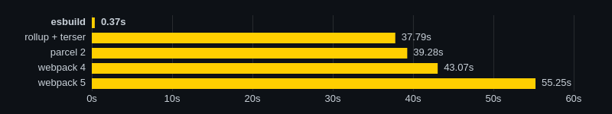
ESBuild
The main goal of the esbuild bundler project is to bring about a new era of build tool performance, and create an easy-to-use modern bundler along the way.
Notes:
‹#›

Slide 7
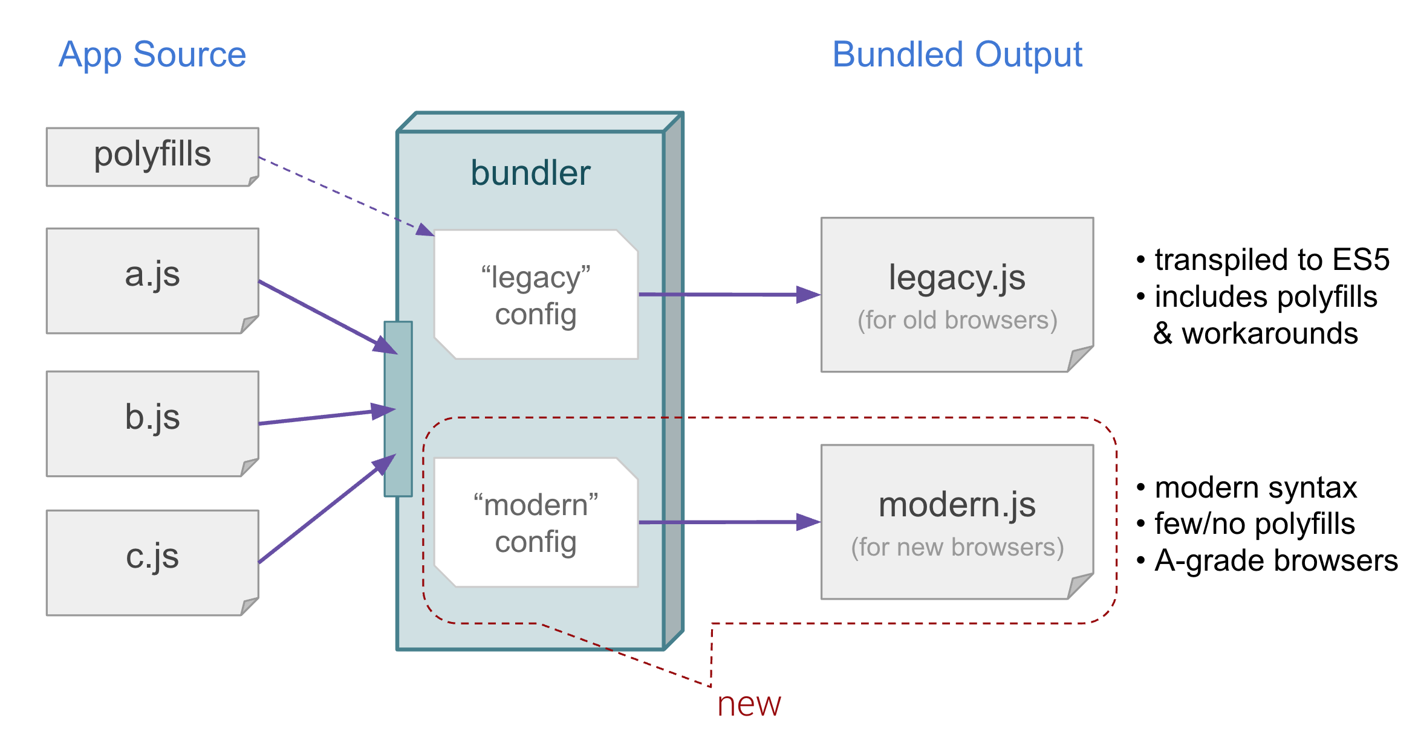
JavaScript Transpiling and Bundling
Notes:
‹#›

Slide 8
iframes
An IFrame (Inline Frame) is an HTML document embedded inside another HTML document on a website.
The IFrame HTML element is often used to insert content from another source, such as an advertisement, into a Web page.
Although an IFrame behaves like an inline image, it can be configured with its own scrollbar independent of the surrounding page's scrollbar..
Notes:
‹#›

Slide 9
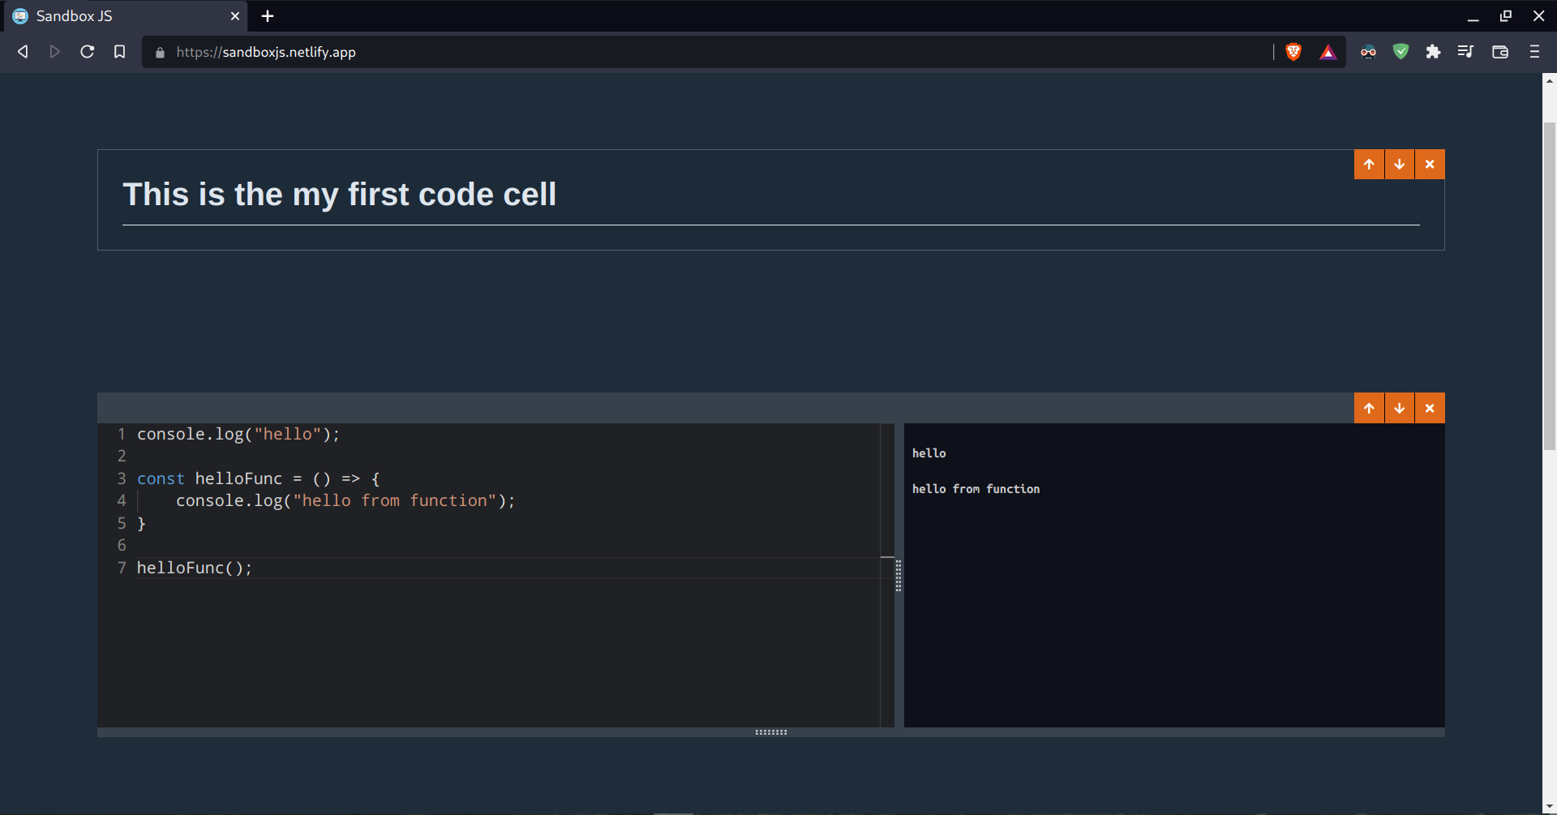

Slide 10
Thank You
Notes:
‹#›

